Slide 2

Applied Algorithm Lab
Warehouse

Slide 3
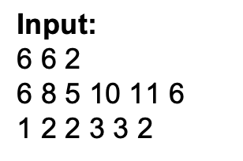
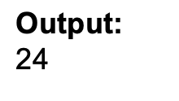
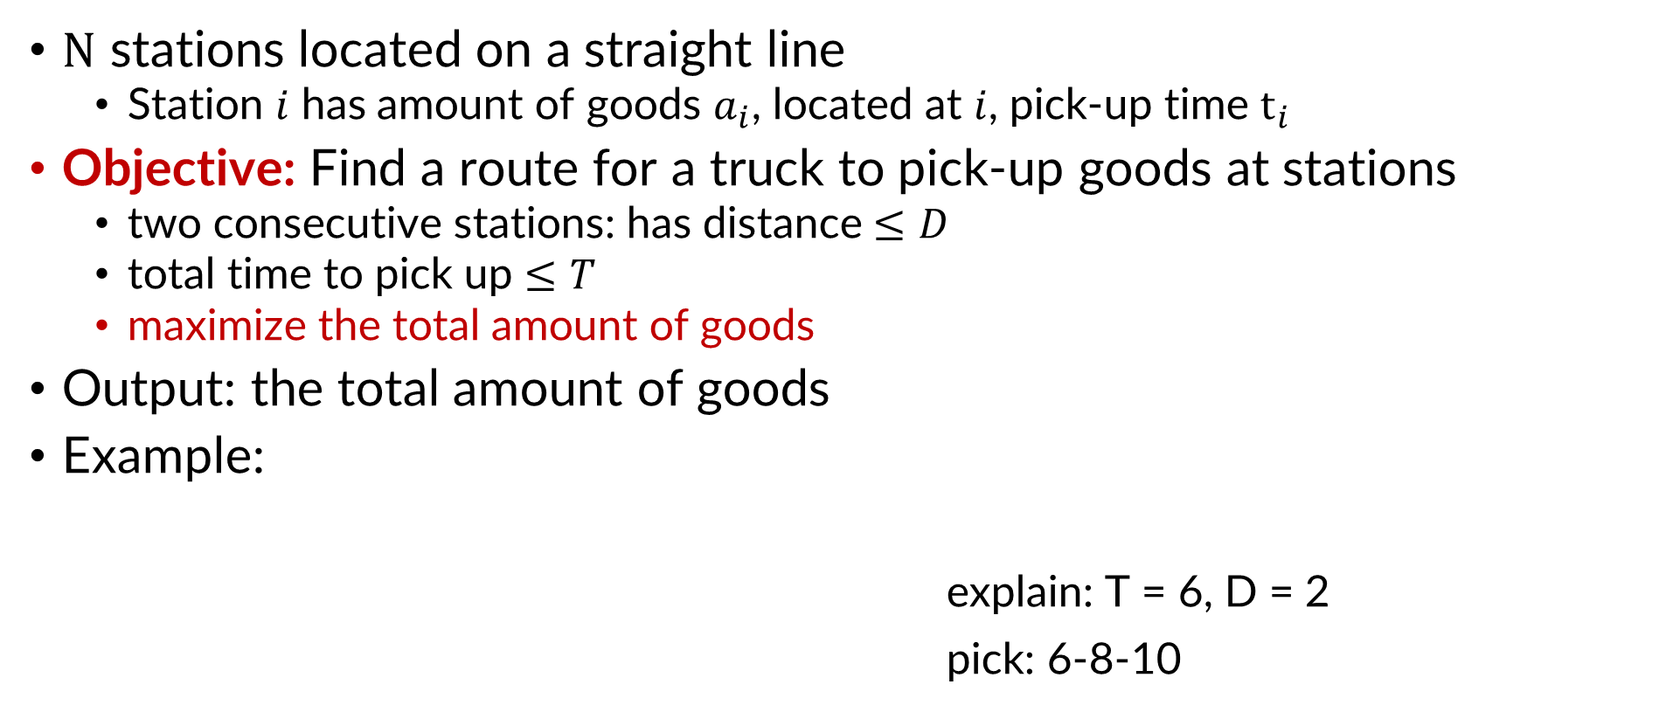
Warehouse
$N$ stations located on a straight line
Station $i$ has amount of goods $a_{i}$, located at $i$, pick-up time $t_{i}$
Objective: Find a route for a truck to pick-up goods at stations
two consecutive stations: has distance $≤D$
total time to pick up $≤T$
maximize the total amount of goods
Output: the total amount of goods
Example:
explain: T = 6, D = 2
pick: 6-8-10

Slide 4
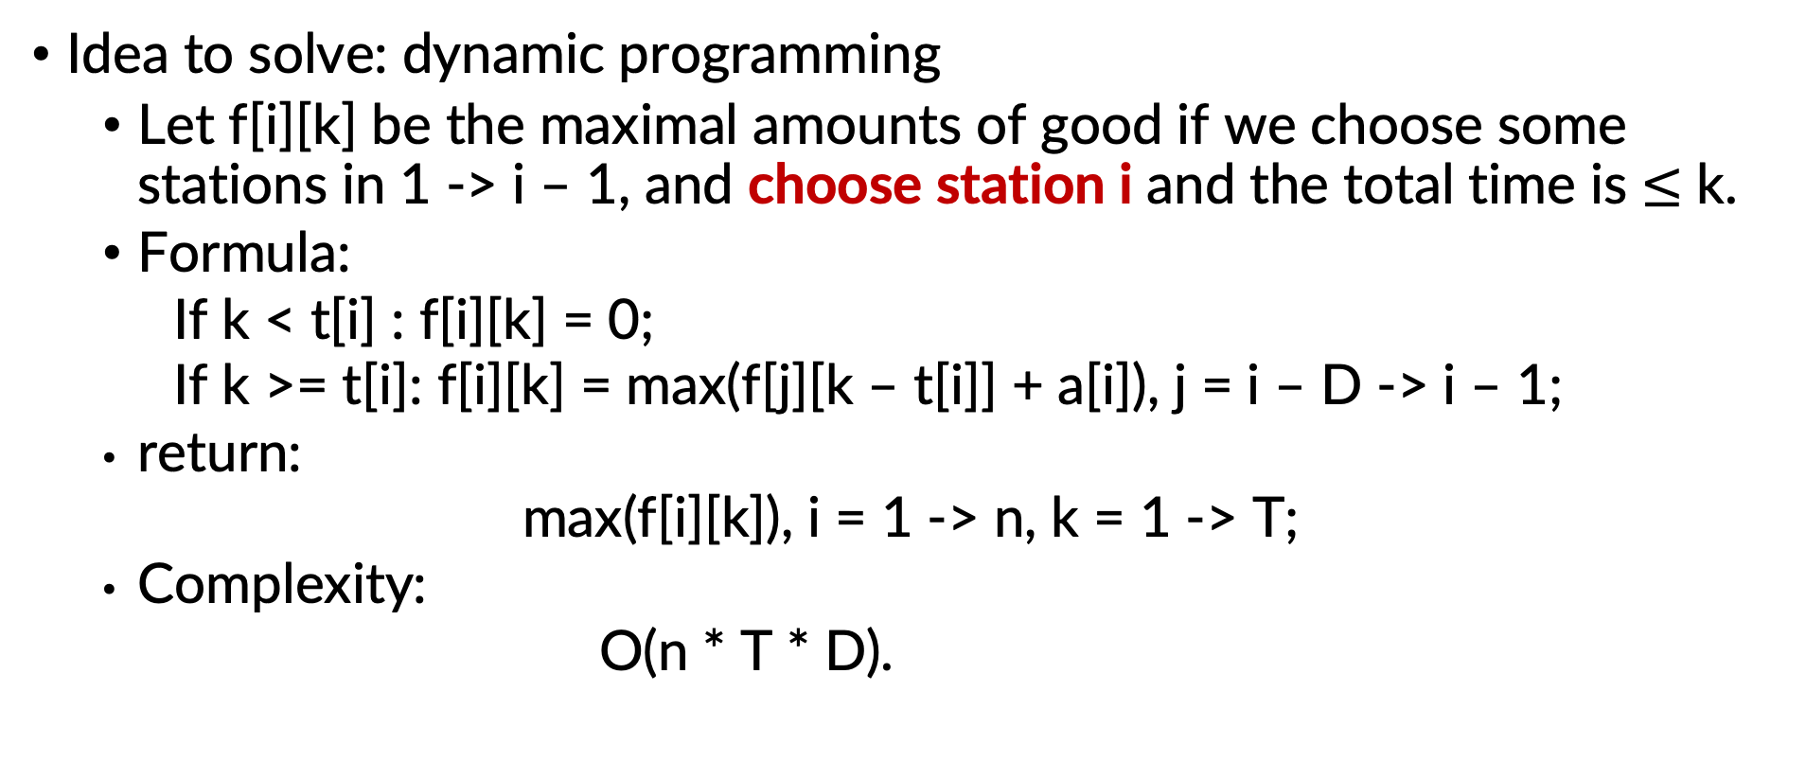
Warehouse
Idea to solve: dynamic programming
Let f[i][k] be the maximal amounts of good if we choose some stations in 1 -> i – 1, and choose station i and the total time is $≤$ k.
Formula:
If k < t[i] : f[i][k] = 0;
If k >= t[i]: f[i][k] = max(f[j][k – t[i]] + a[i]), j = i – D -> i – 1;
return:
max(f[i][k]), i = 1 -> n, k = 1 -> T;
Complexity:
O(n * T * D).

Slide 5
THANK YOU !

